Slide 1
Searching Techniques
Search Engines
Dr. M. Tanvir Afzal

Slide 2
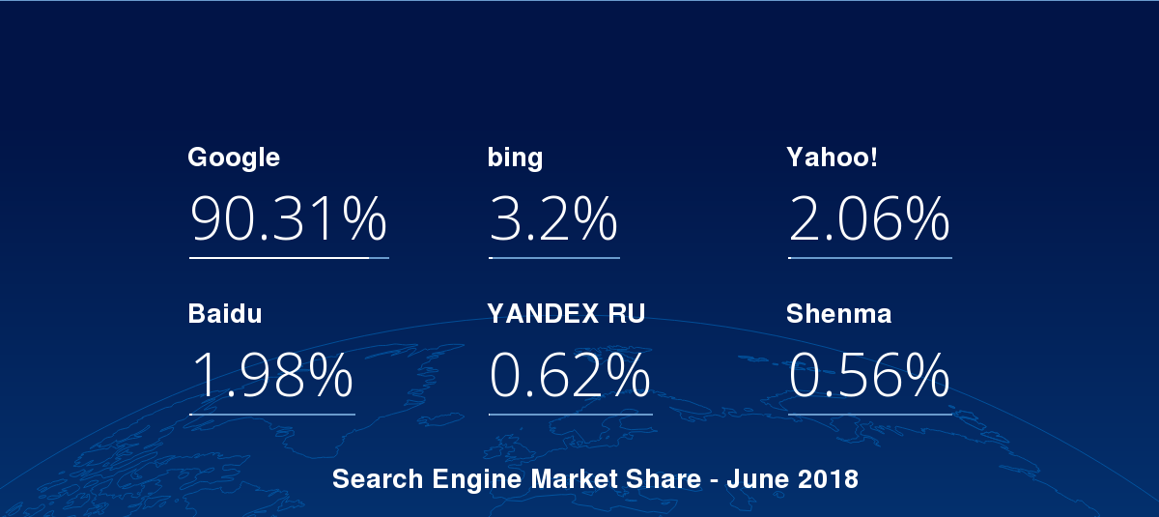
Search Engines
Google
Bing
Yahoo
http://gs.statcounter.com/search-engine-market-share
Dr. M. Tanvir Afzal

Slide 3
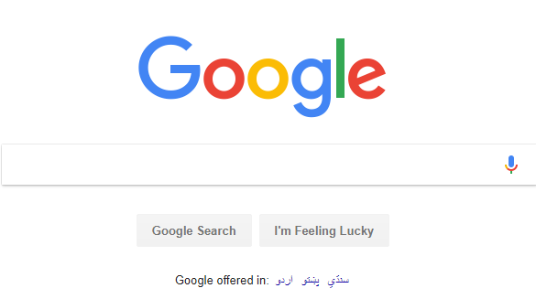
Google
https://www.google.com/
Dr. M. Tanvir Afzal

Slide 4
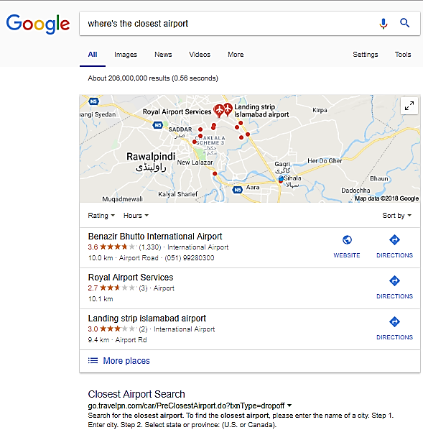
Query Formulation
Start with simple terms

Slide 5
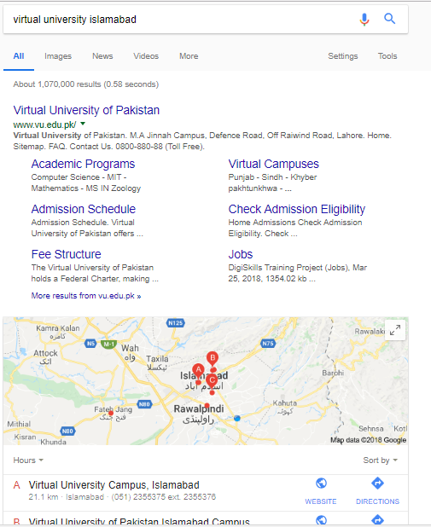
Query Formulation
Specify location:
Dr. M. Tanvir Afzal

Slide 6
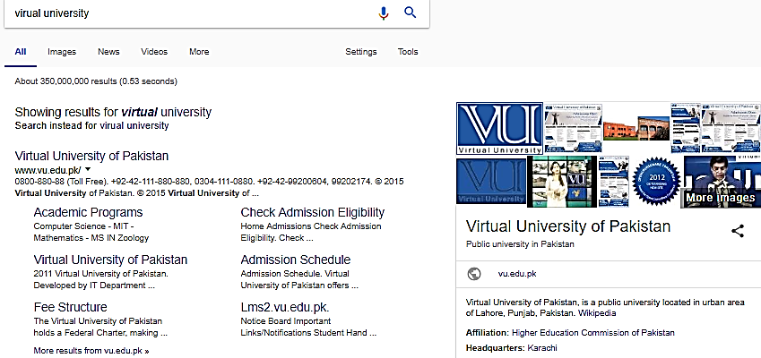
Query Formulation
Spelling

Slide 7

Query Formulation
Search using voice:

Slide 8
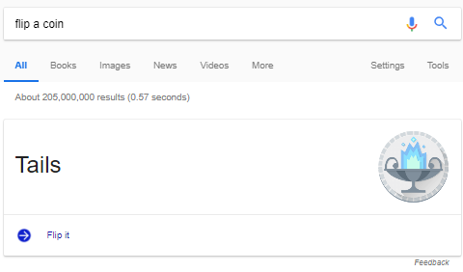
Query Formulation
Flip a Coin:
Dr. M. Tanvir Afzal

Slide 9
Query Formulation
Choose Words Carefully
Head hurts/headache
head virtual university/Rector Virtual University
Remote Education/Virtual education
Apple could point to company and fruit
Dr. M. Tanvir Afzal

Slide 10
Query Formulation
Capitalization
COMPUTER SCIENCE
VS
computer science
Dr. M. Tanvir Afzal

Slide 11
Summary
Search Engines
Google searching tips and effective query formulation
Dr. M. Tanvir Afzal

